Slide 1

Telemedicine Application
Team Members
Tejaswi Allam
Keerthi Kamidi
Asha Noorbasha
Tirumala Arikatla
Nikitha Sri Garapati

Slide 2

Project Outline
Introduction
Problem Statement
Proposed Solution
Functional Requirements
Nonfunctional Requirements
Data management plan
Use Cases
What have been accomplished?
Lessons learnt till now

Slide 3

INTRODUCTION
The main objective of the Telemedicine Application is to streamline healthcare delivery by offering a unified platform for consultations, medical records, and prescriptions.
This solution aims to reduce inefficiencies in current healthcare systems by improving access to remote care, enhancing communication between doctors and patients, and providing secure data management. Additionally, it seeks to ensure real-time updates, ease of use, and compliance with medical privacy standards to improve patient satisfaction and care outcomes.
The goal is to provide a secure, user-friendly, and efficient platform where patients can consult with doctors, manage their health data, and access services like appointment booking and prescriptions without the need to visit healthcare facilities in person.

Slide 4
Problem Statement
The current healthcare system is inefficient and fragmented, requiring patients to visit healthcare facilities in person for consultations, leading to long wait times and travel burdens, especially for individuals with mobility issues or living in remote areas.
Challenges with Appointment and Medical Record Management: Patients struggle with booking appointments, reminders, and managing medical records across multiple systems, leading to missed appointments and incomplete records.
Prescription Management Issues: Delays in receiving prescriptions due to miscommunication between doctors and pharmacies, often requiring follow-ups.
Difficulty in Accessing Past Medical Records: Patients find it challenging to access or share their medical records across various healthcare providers, causing incomplete or delayed diagnoses.
Security and Privacy Concerns: Many platforms fail to follow strict privacy regulations, putting sensitive patient data at risk.
Lack of a Unified System: The absence of a secure, efficient, and unified telemedicine platform hinders timely care, lowers patient satisfaction, and reduces healthcare efficiency.

Slide 5

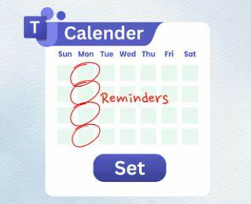


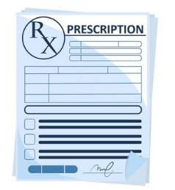


Proposed Solution
User Registration & Profile Management
Schedule Appointment
Receive Reminders
Video consultation
Prescription Management
Secure Messages
Manage Medical Records

Slide 6
Functional Requirements
Register users as a patient or a doctor.
Patients to view available doctors and book appointments.
Patients to cancel or reschedule appointments.
Doctors to manage availability
patients to receive confirmation and reminders.
Real-time video and audio communication between patient and doctor.
Secure Medical Records
Doctors to generate and send digital prescriptions.
List of pharmacies.
Secure messaging platform for consultations or follow-up questions
Include additional features like multimedia messaging or in-app voice notes.
Insurance verification and claims.
General feedback on the app experience.
Include pharmacy integration.
Patients to pay consultation fees through integrated payment gateways.
Patients to input insurance details and check Coverage.
In-app access to frequently asked questions and support articles.
MAY
MUST
SYSTEM
SHOULD
NOT
Allow any form of data transmission that is not encrypted.
Allow any features or practices that allow unauthorized access to sensitive user data.
For more details:
Functional Requirements List (Iteration 2) · Tejaswireddyallam/GDPFall2024-Group2 Wiki (github.com)

Slide 7
Non-functional REQUIREMENTS
Ensure automatic synchronization of data across all devices in real-time
The app must ensure low-latency video streaming to provide a seamless consultation experience
Fast appointment, prescription, record processing.(< 5 sec)
The app must be accessible 24/7
Data consistency
Video calls and chats should be encrypted
provide a secure messaging platform for consultations
The app must comply with HIPAA to ensure privacy
Add multi-factor authentication (MFA)
Performance
Security
The app should have an intuitive, easy-to-navigate interface for patients, with simple steps for booking appointments and accessing medical records.
Usability
Scalability
The telemedicine app must be scalable to accommodate an increasing number of users, consultations, and appointments.

Slide 8
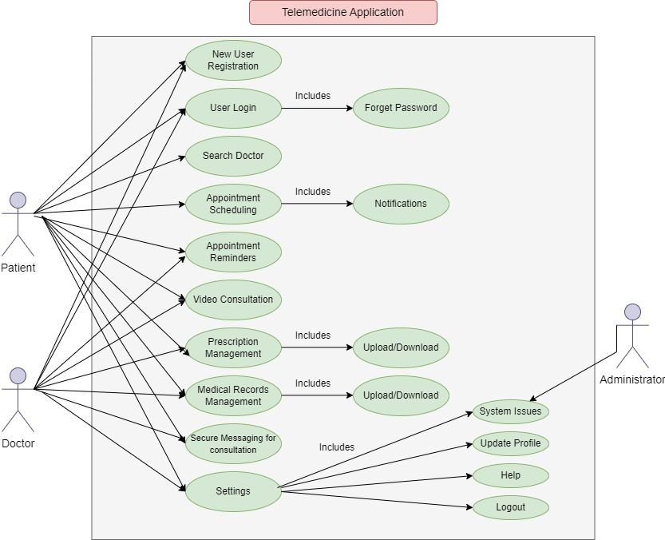
Use cases
Use Cases (Iteration 2) · Tejaswireddyallam/GDPFall2024-Group2 Wiki (github.com)

Slide 9
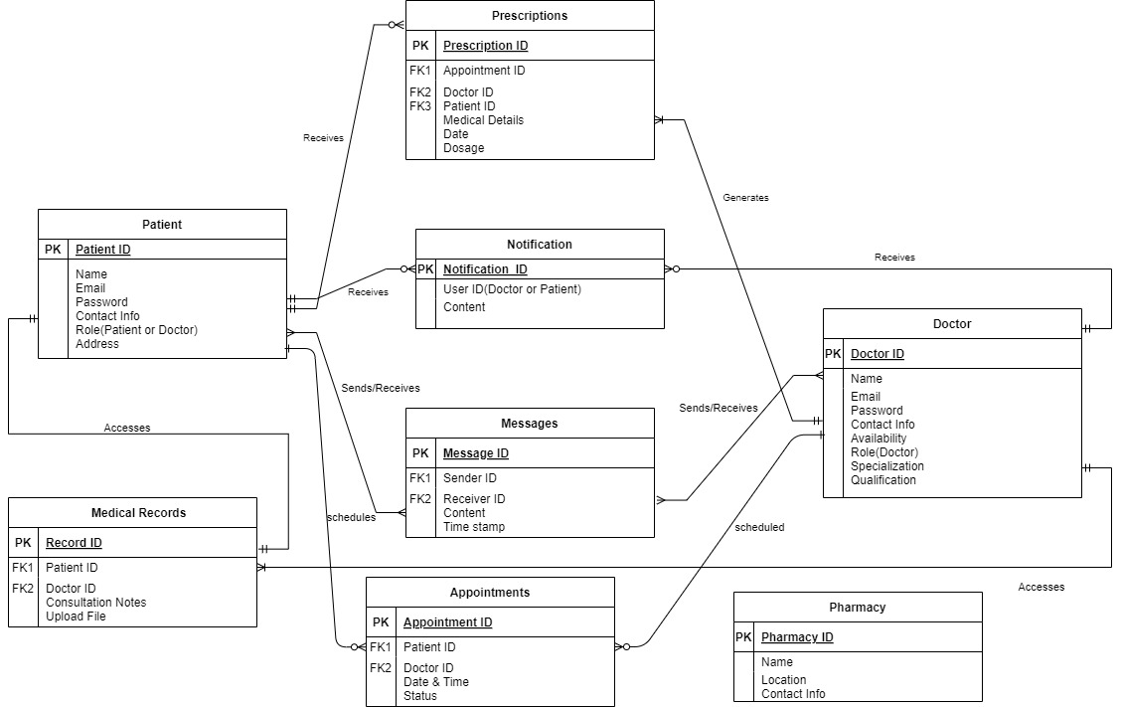
Data Management plan
Data Management Plan (Iteration 1) · Tejaswireddyallam/GDPFall2024-Group2 Wiki (github.com)

Slide 10
What Have Been Accomplished?
Thorough documentation of functional requirements, nonfunctional requirements ,use cases, and prototypes for the telemedicine application.
Created detailed prototypes for key application features, including user login, registration, and dashboard functionalities.
Identified and documented essential features like appointment scheduling, video consultations, and prescription management.
Developed ER diagrams and flowcharts to enhance understanding of system architecture and workflows.
Established clear milestones and timelines for the development phase, enhancing project management

Slide 11
LESSONS LEARNT
Effective Documentation of Functional Requirements: We've learned the importance of clearly defining functional requirements to ensure that both development and stakeholder expectations align. Structured documentation has been crucial for tracking progress and maintaining focus.
Importance of ER Diagrams: ER diagrams have proven invaluable in visually mapping out the relationships between entities like patients, doctors, and appointments. This helped us better understand data flows and dependencies within the system.
Conducting comprehensive research and analysis enables us to identify the project's requirements effectively
Team Collaboration: The process has emphasized the importance of effective team communication and collaboration during the documentation phase.
Paying attention to client feedback and implementing changes accordingly enhances the quality of our solution.
*****THANK YOU*****

